Slide 1
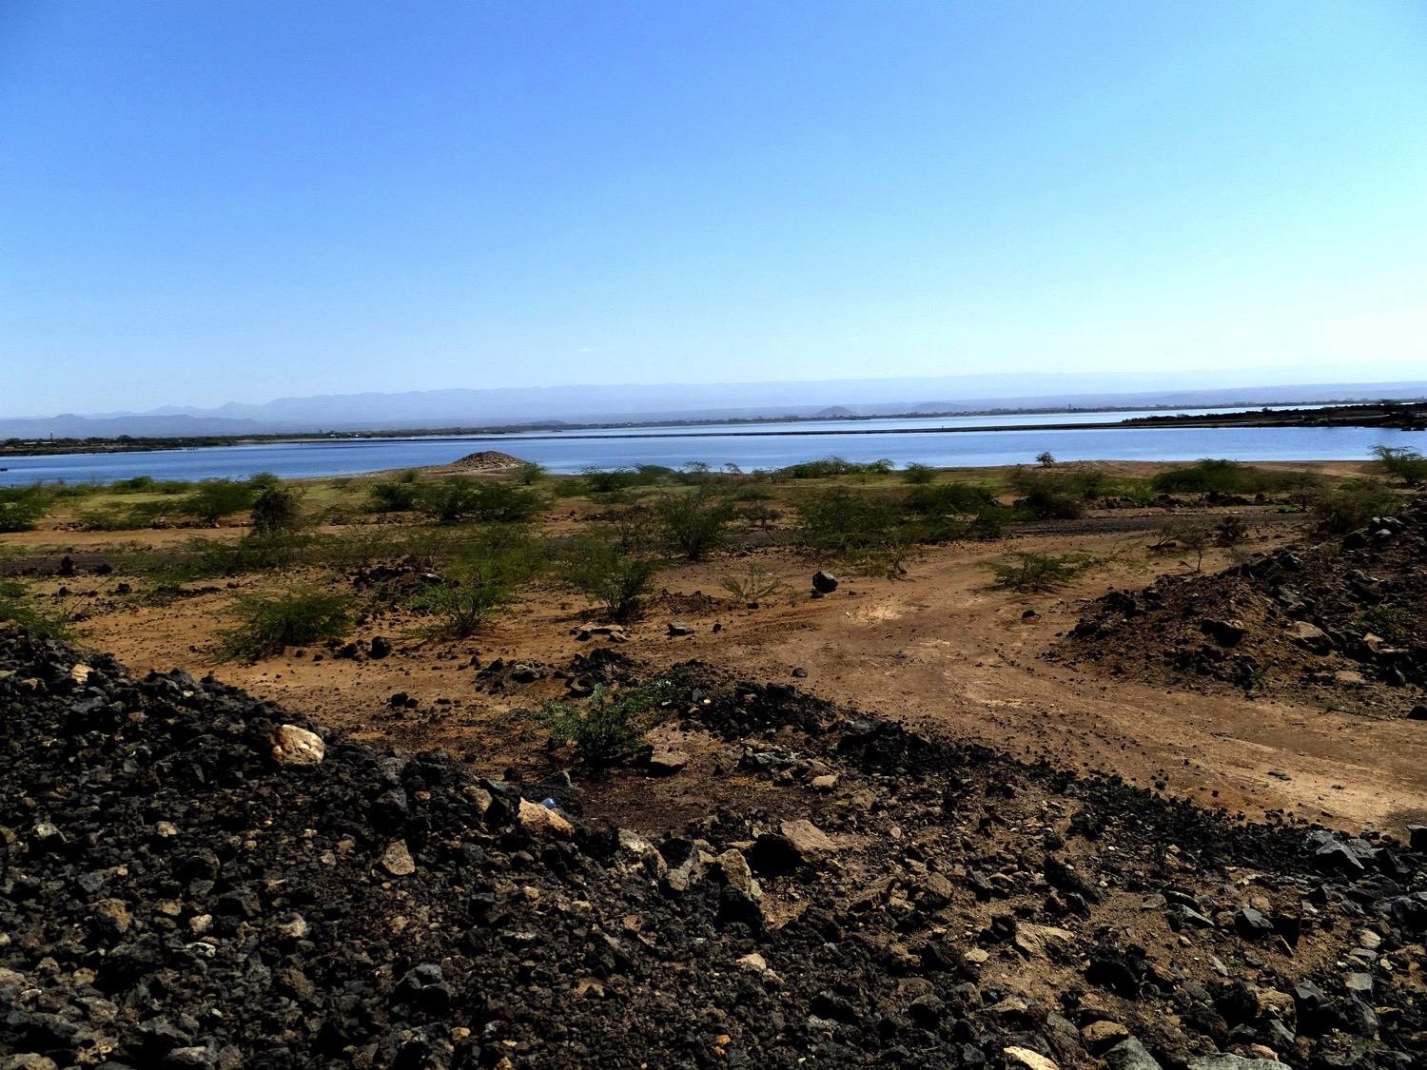
Solar-Power for Africa
Ethiopia

Slide 2
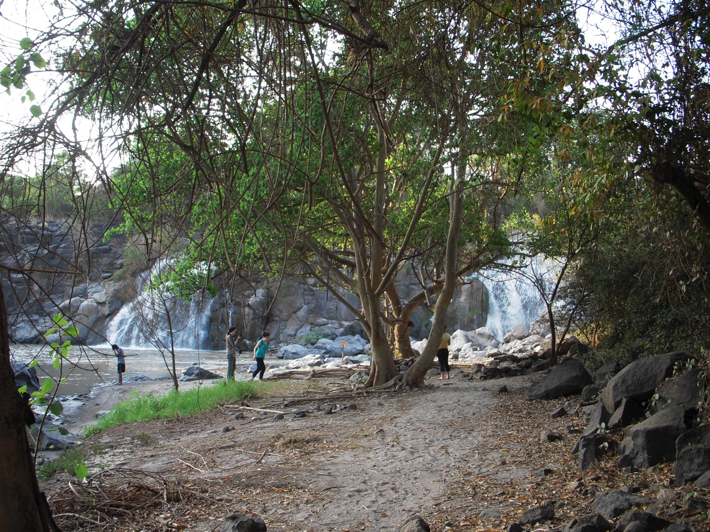

Slide 3
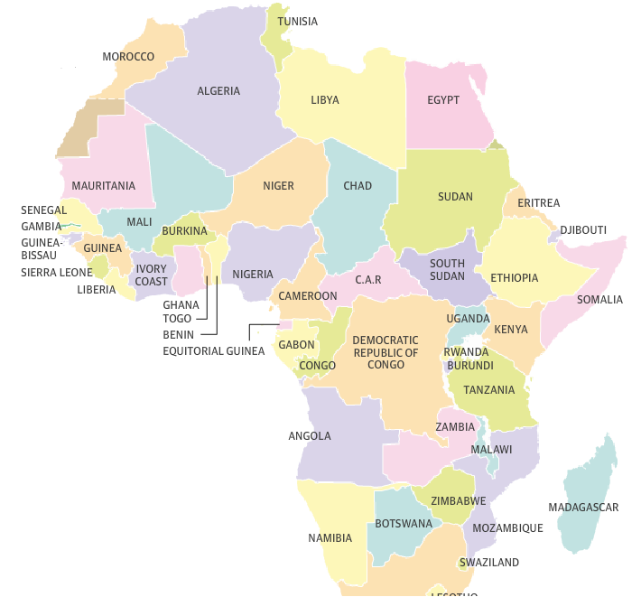
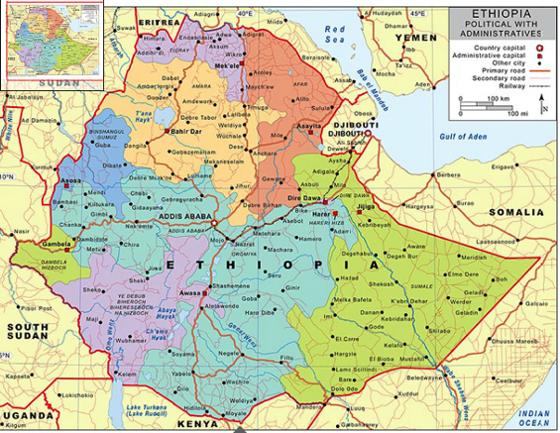
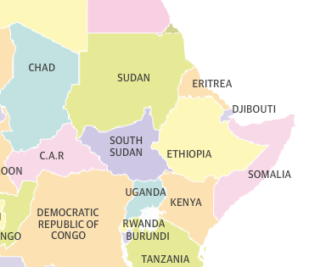

Slide 4
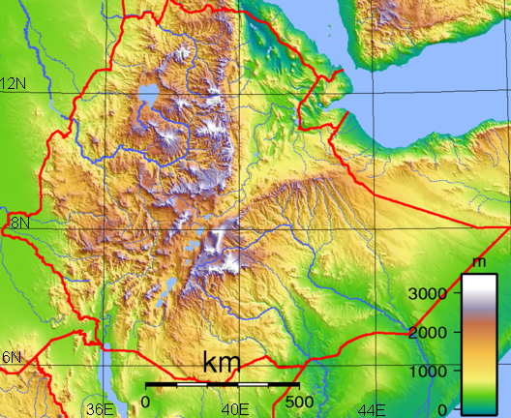
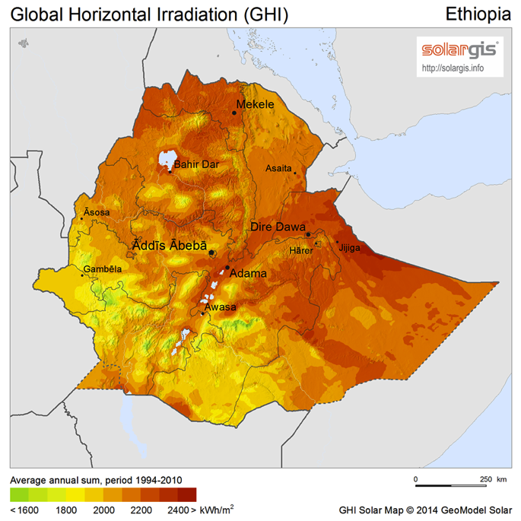
Solar irradiance is the highest on Earth
Typical value in Ohio is ~1200 kWh/m²
Ethiopia is at high altitude and close to the equator (bottom edge of map).
Population about 100 million people.
Mostly rural farmers.

Slide 9



Accomplishments & Impacts
Forge relationships between the University of Cincinnati and Ethiopian undergraduate students
Entrepreneurial approach to development assistance as a partnership
Application of engineering, design, and business training towards a collaborative project that can improve the living standard for rural sub-Saharan communities

Slide 10
What I Gained
Experienced first-hand the lack of accessible water outside of developed communities
Overcame language barriers in order to complete a project
Full immersion into a new culture
Exposed to engineering practices that differ greatly than those used in the US

Slide 11
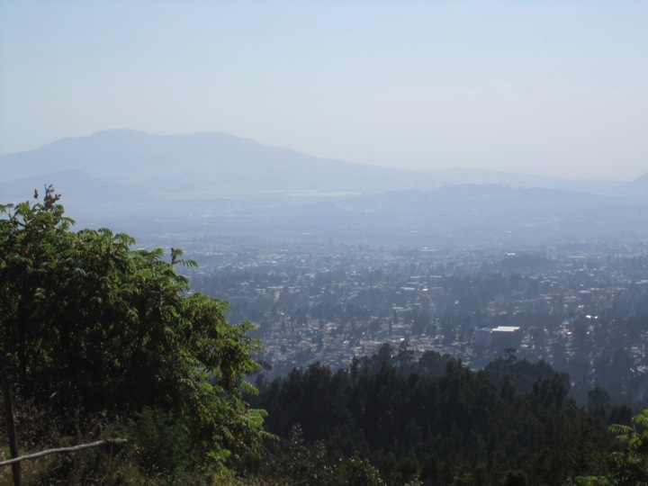

Slide 12
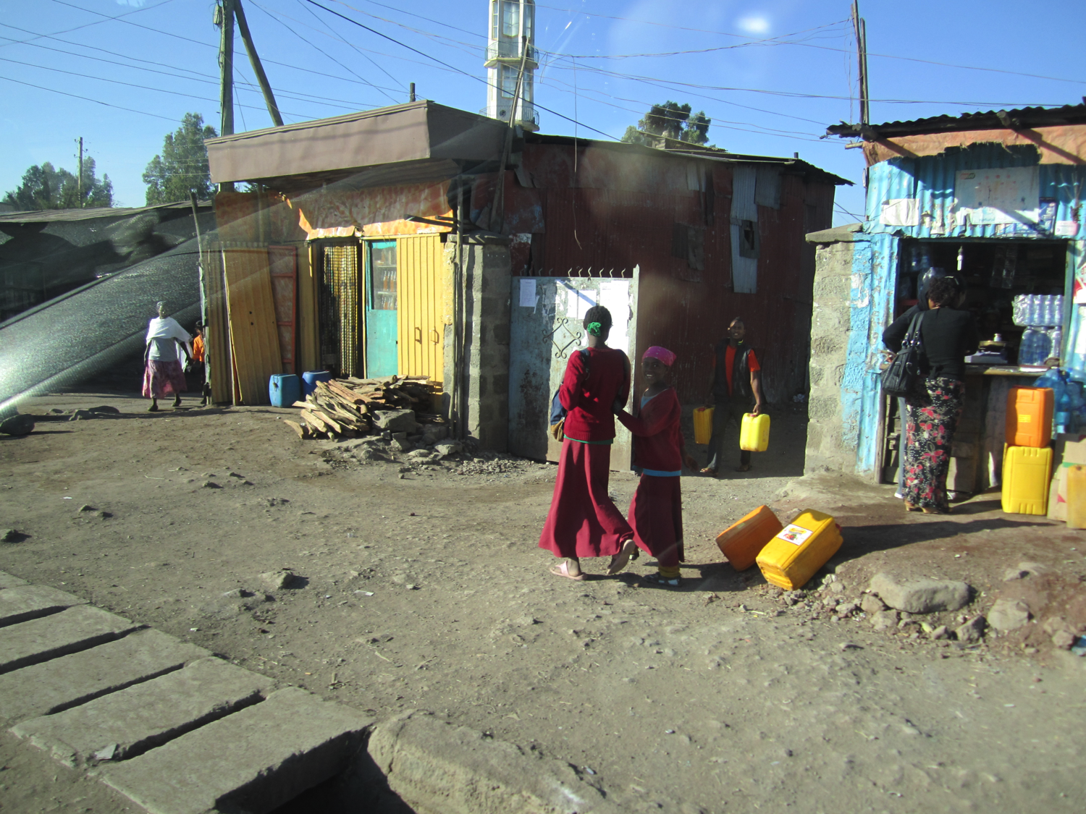

Slide 13
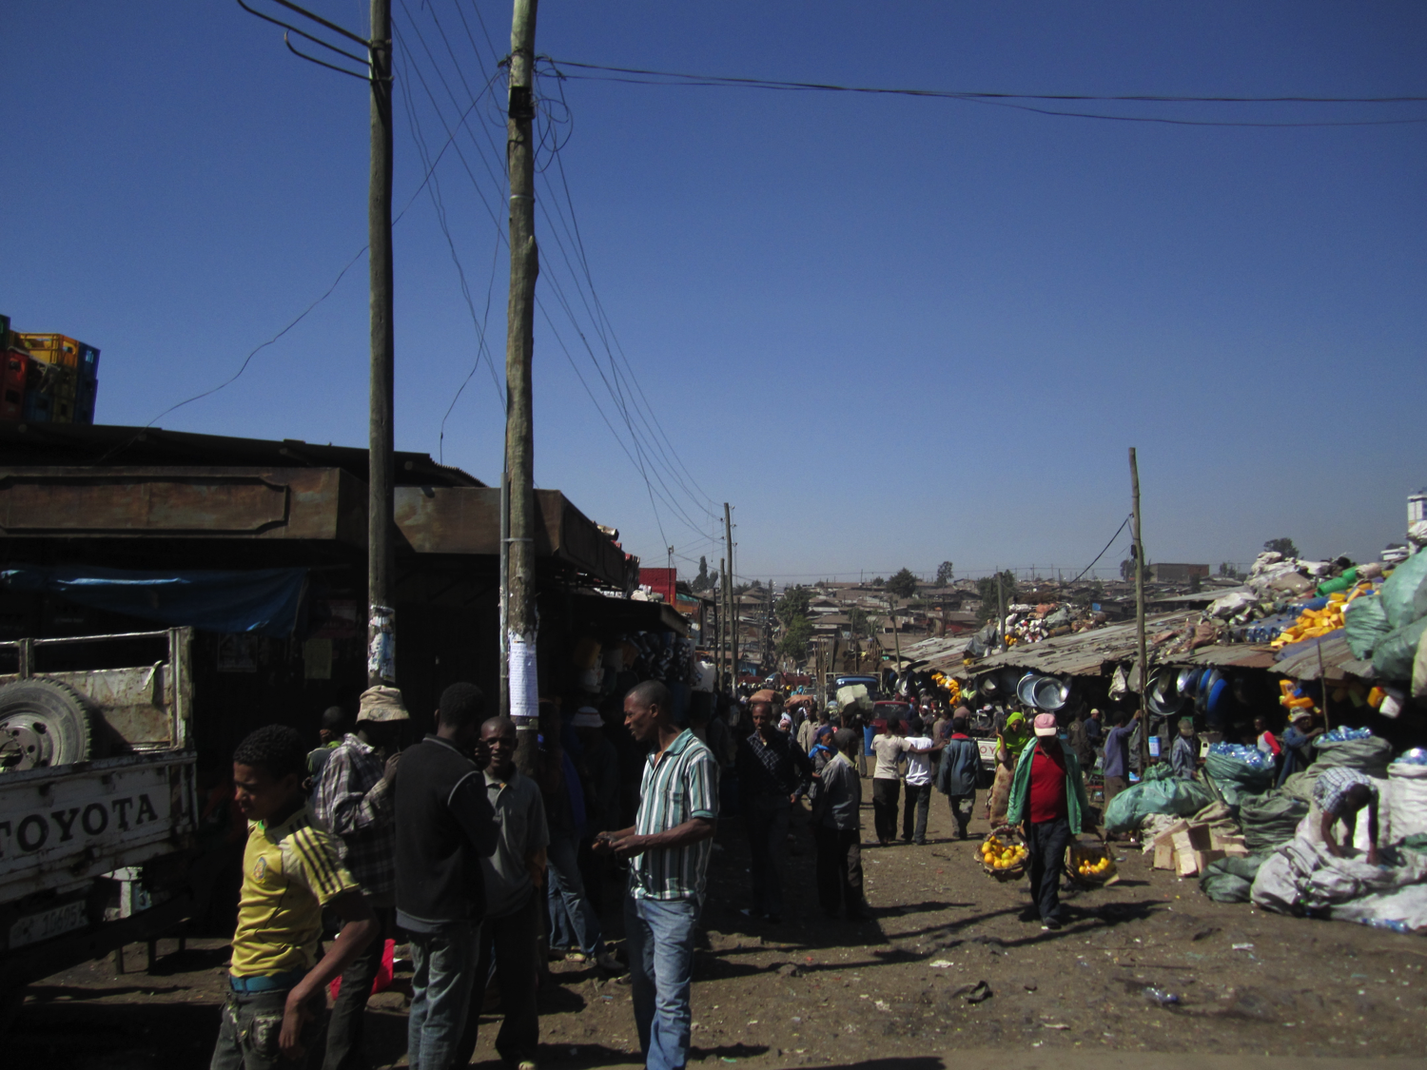

Slide 14
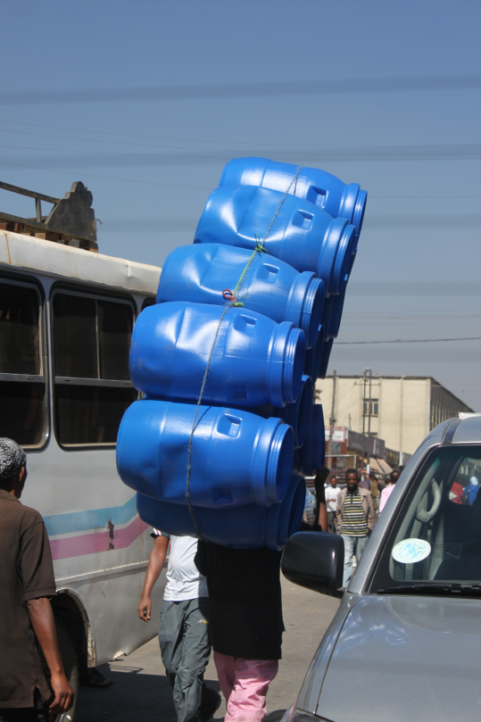
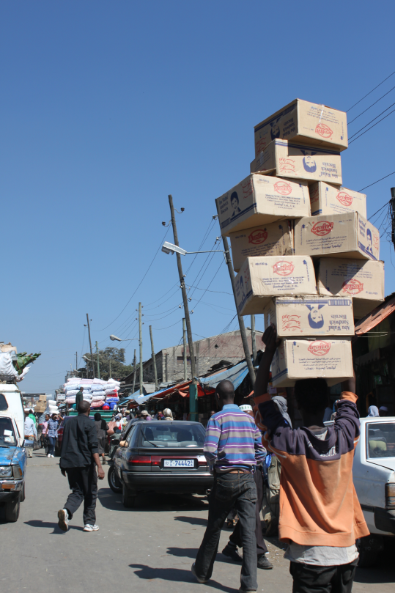

Slide 15
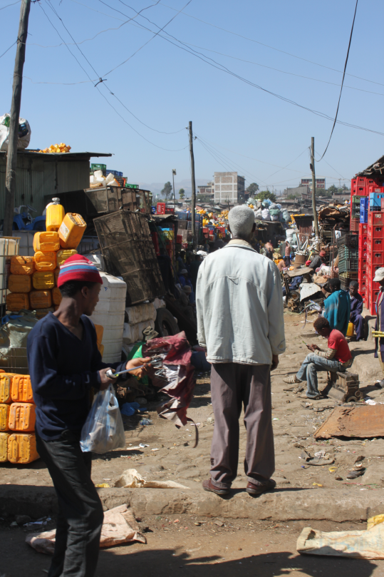
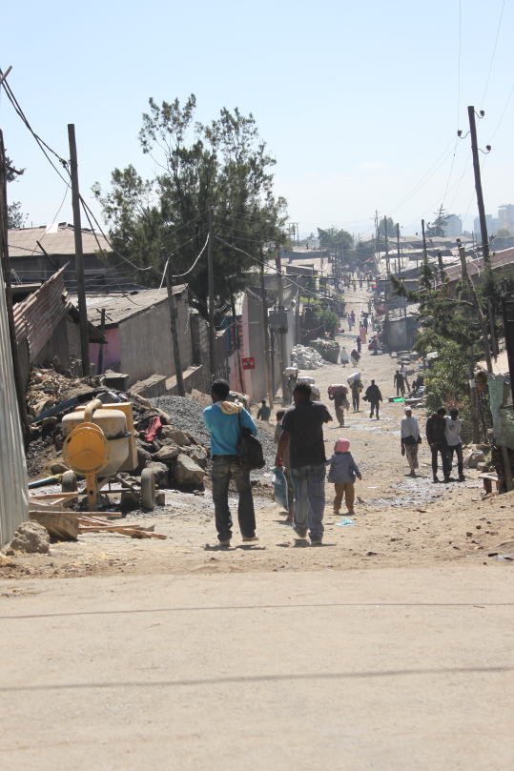

Slide 16
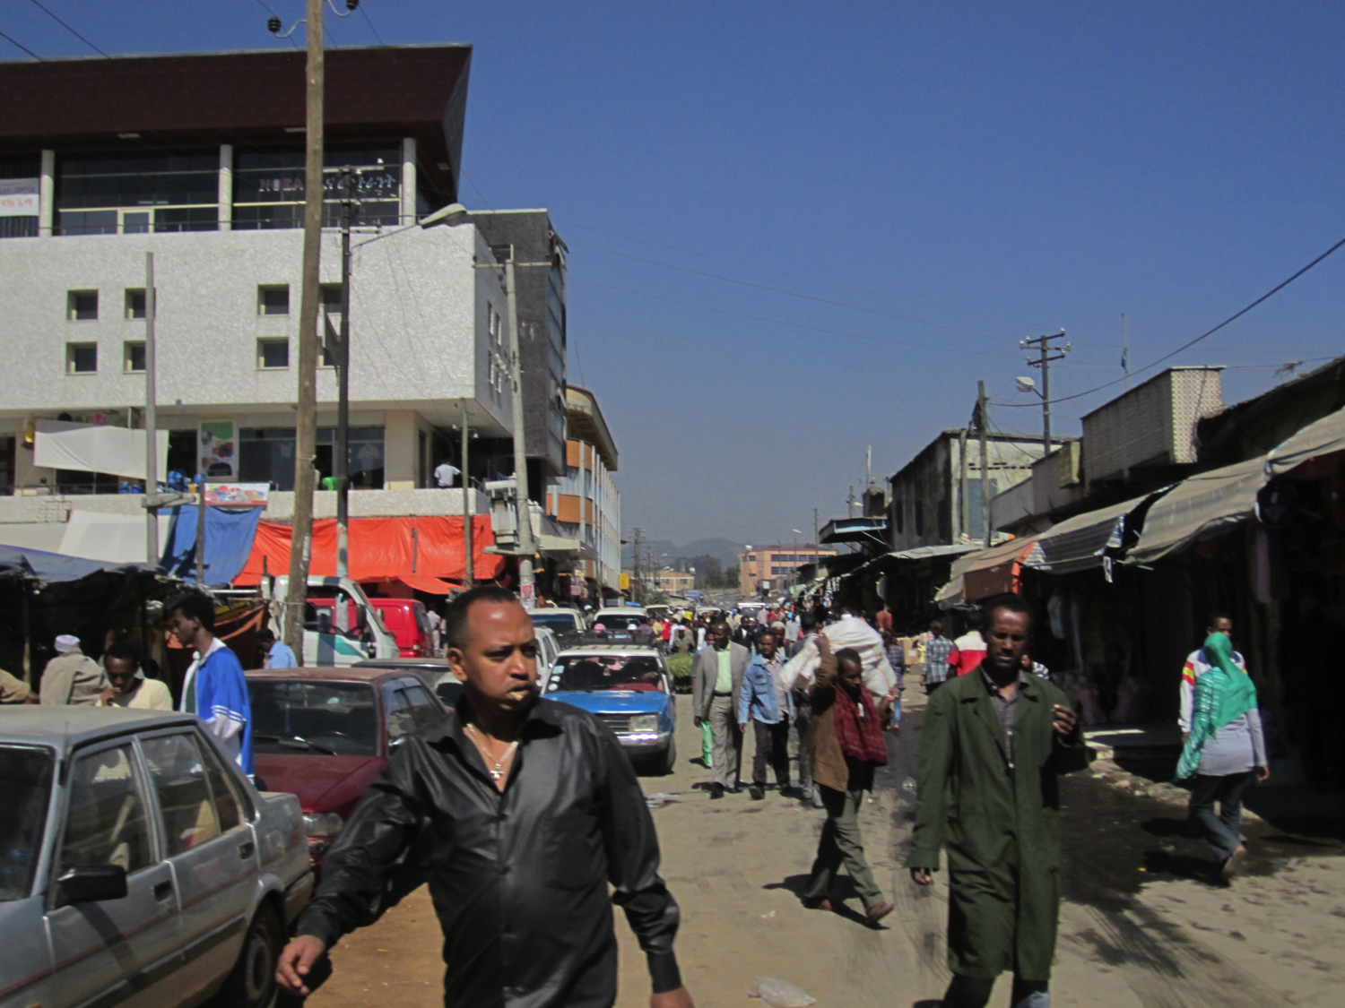

Slide 17
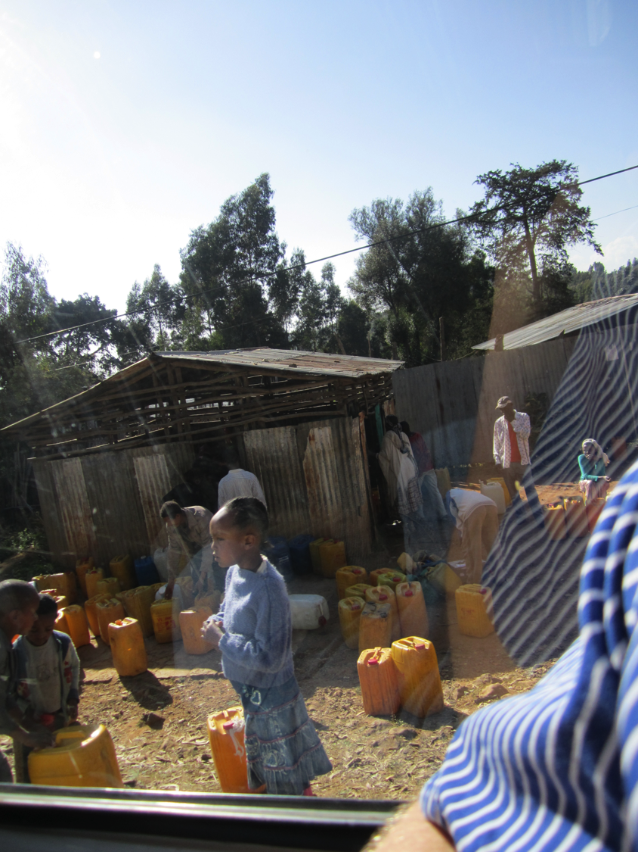

Slide 18
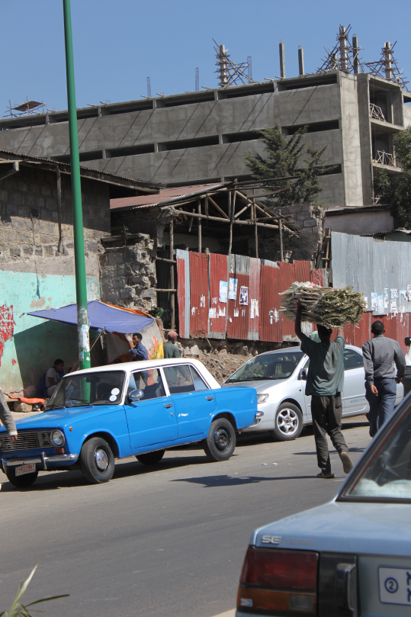

Slide 19
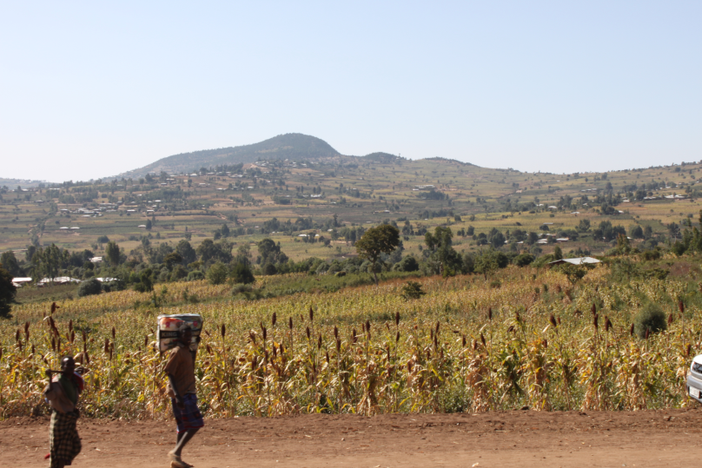

Slide 20
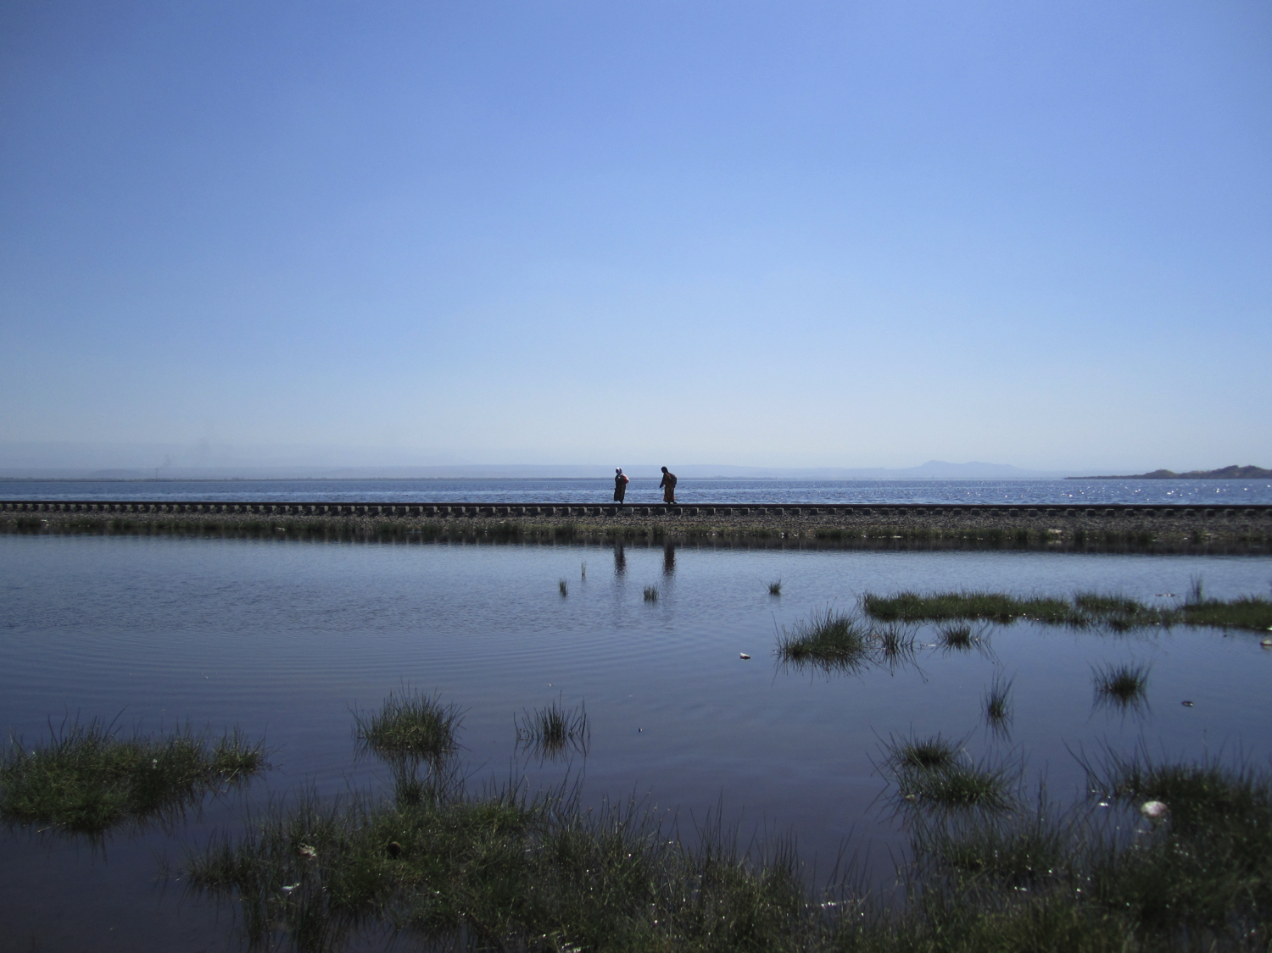

Slide 21
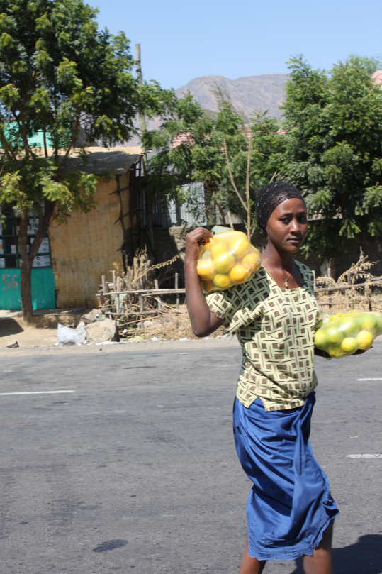

Slide 22
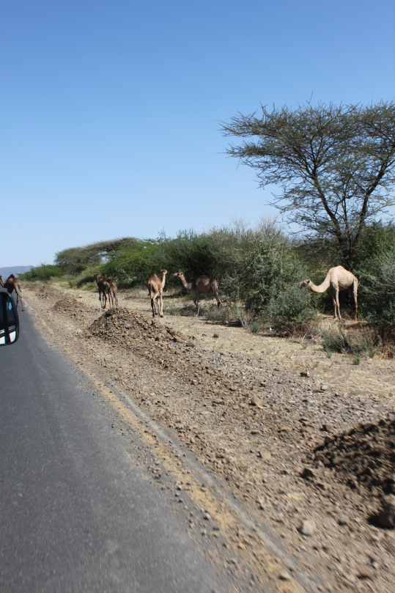

Slide 23
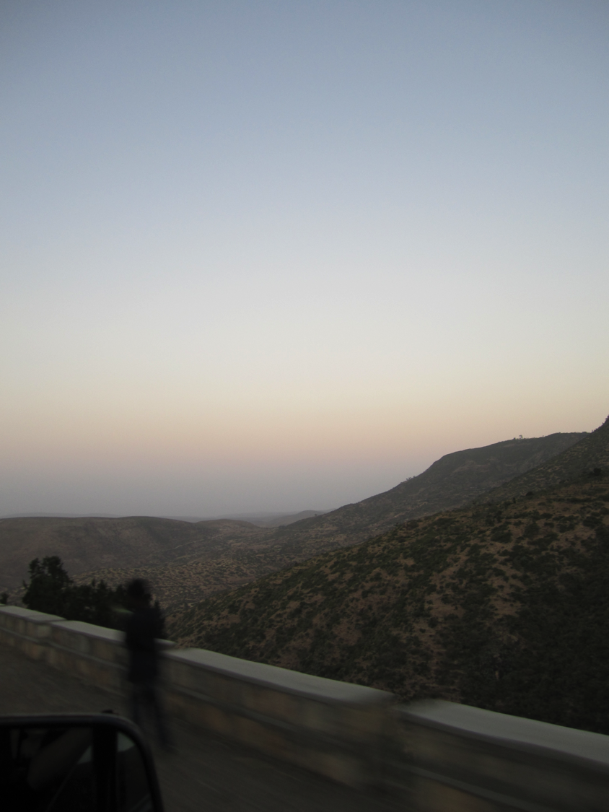

Slide 24
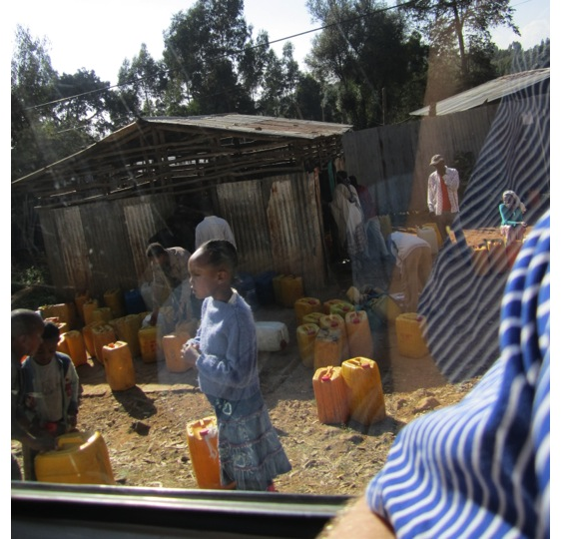

Slide 25
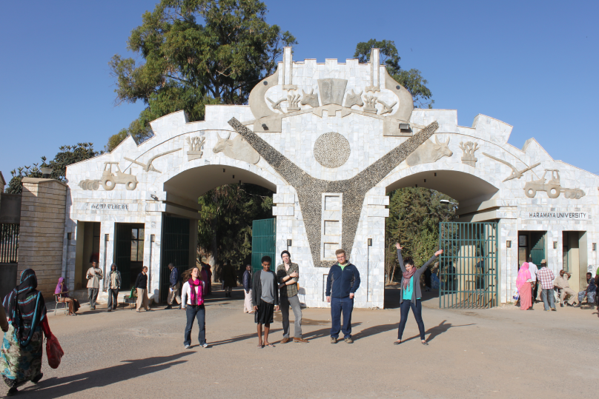

Slide 26
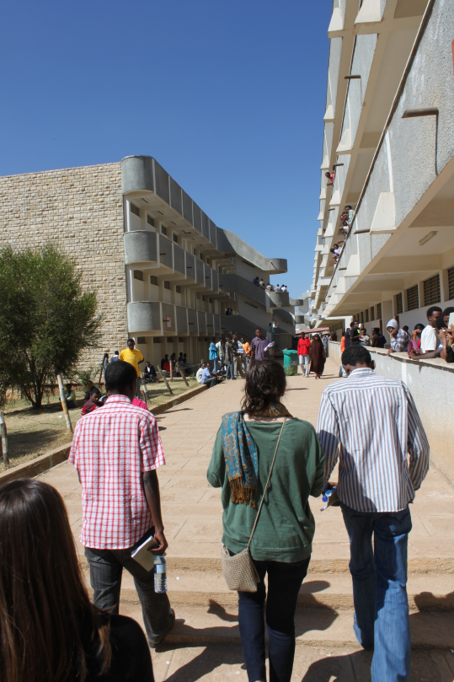

Slide 27
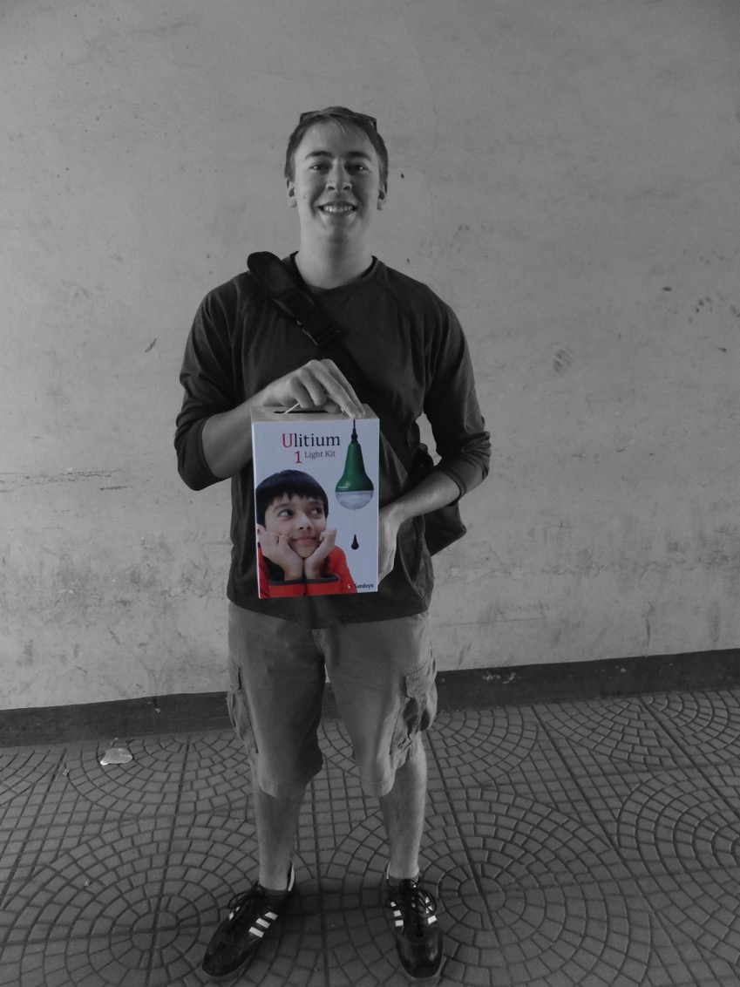

Slide 28
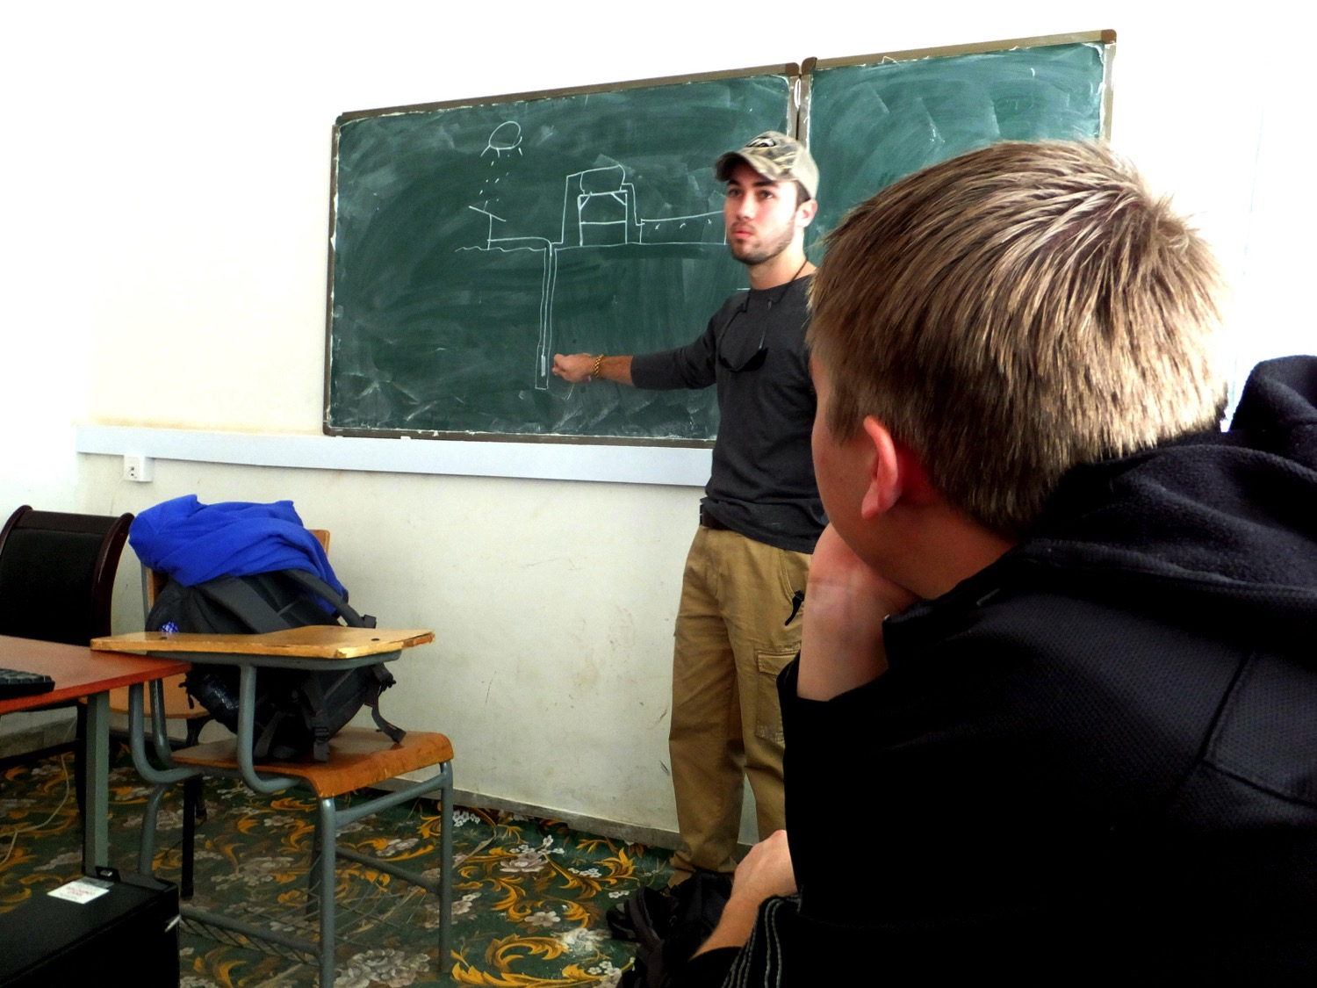
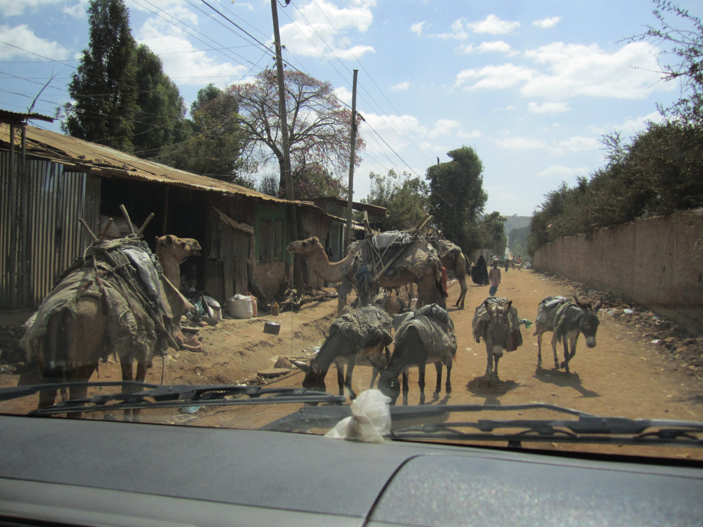

Slide 29
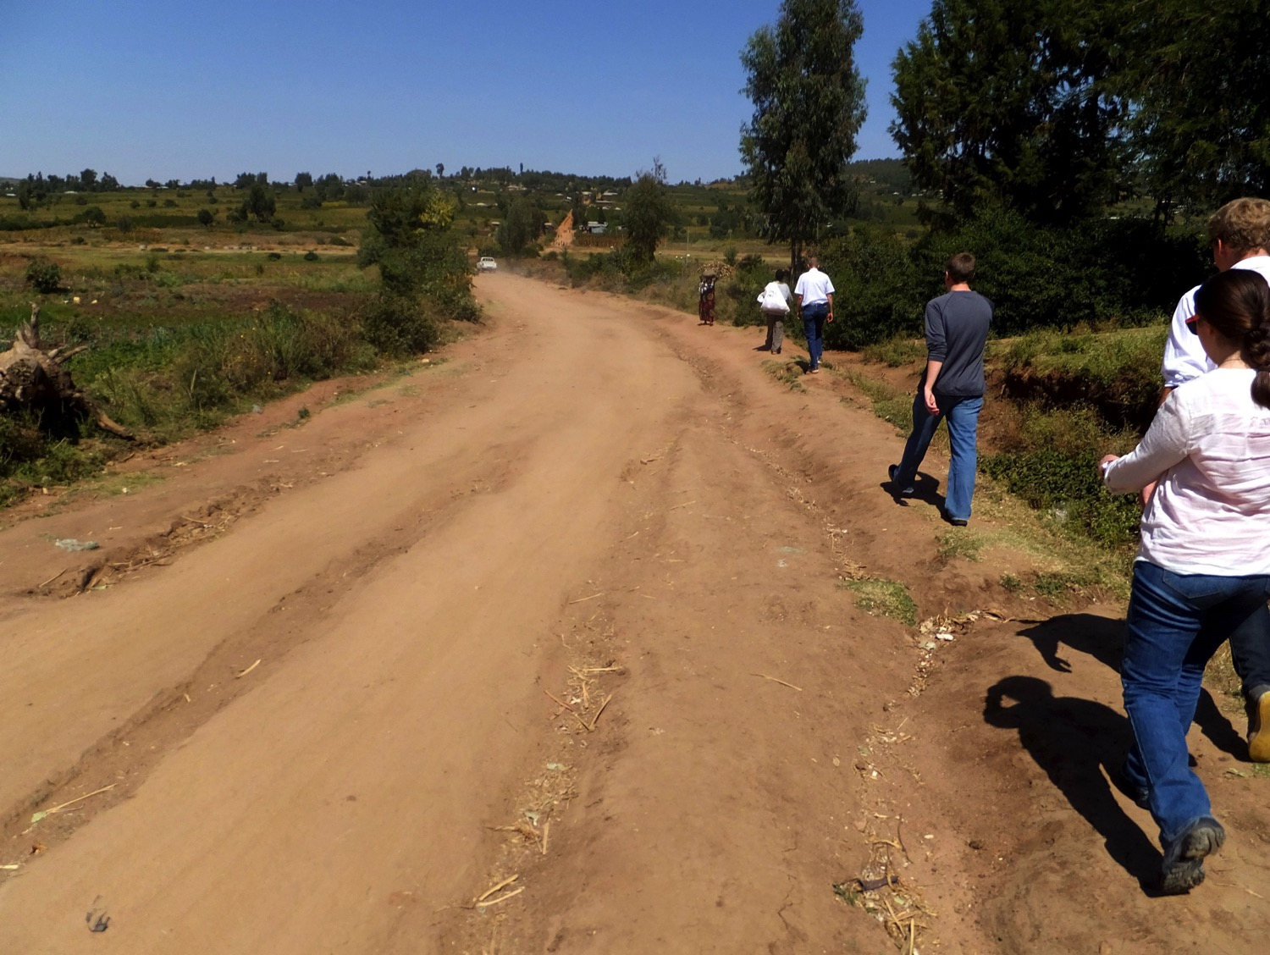

Slide 30
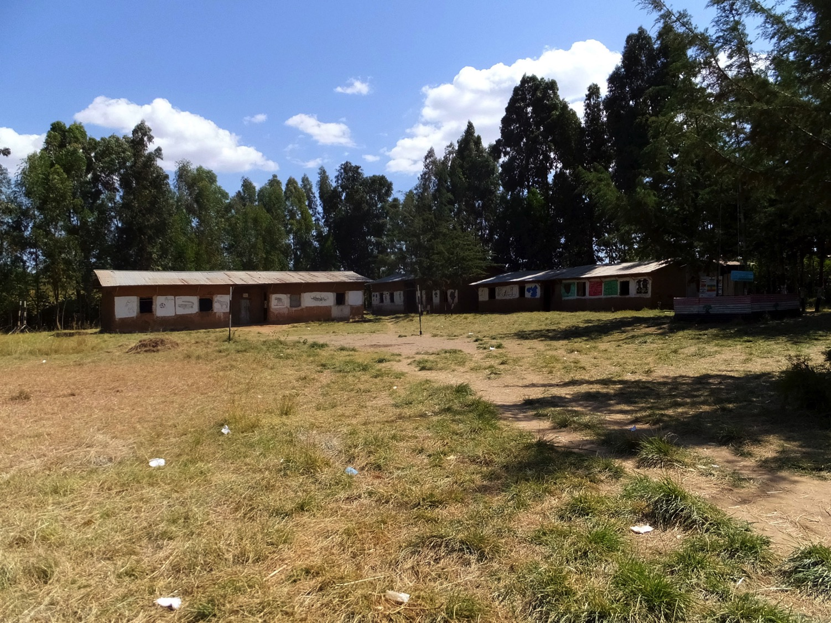

Slide 31
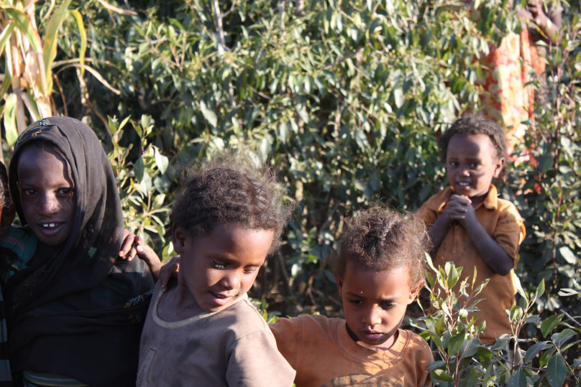

Slide 32
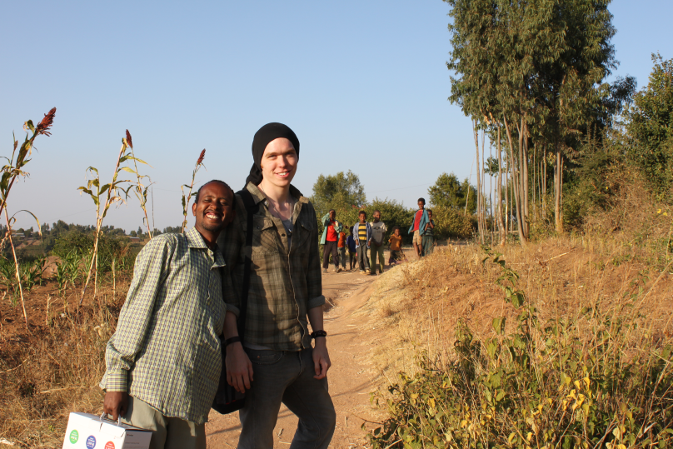

Slide 33
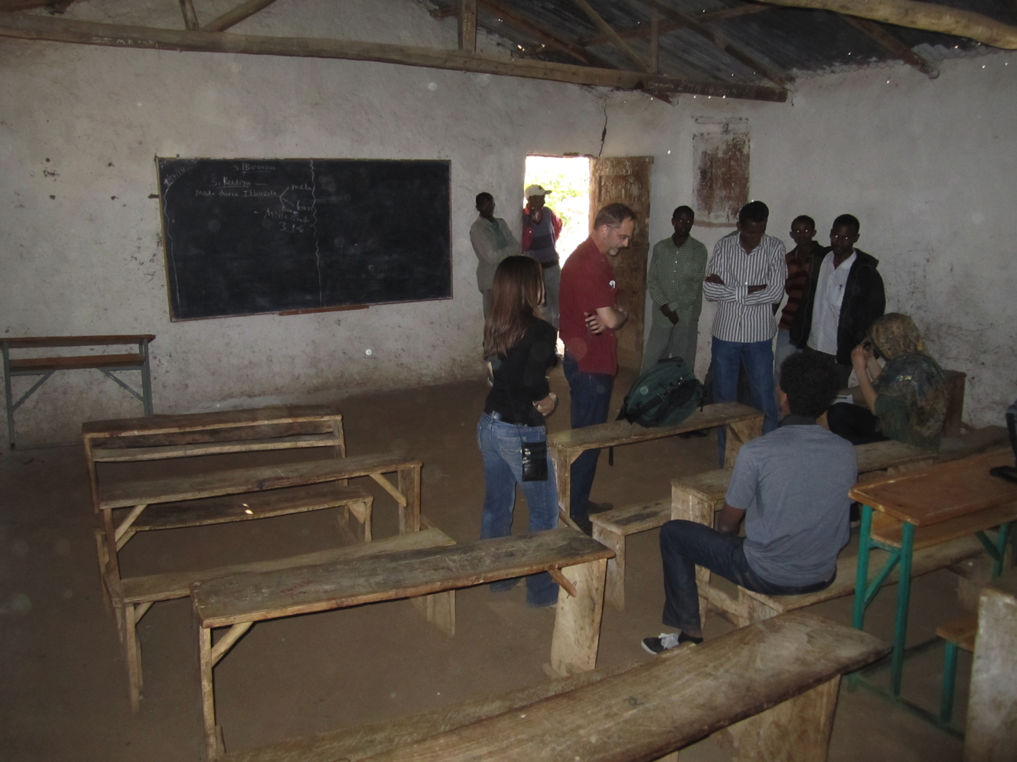

Slide 34
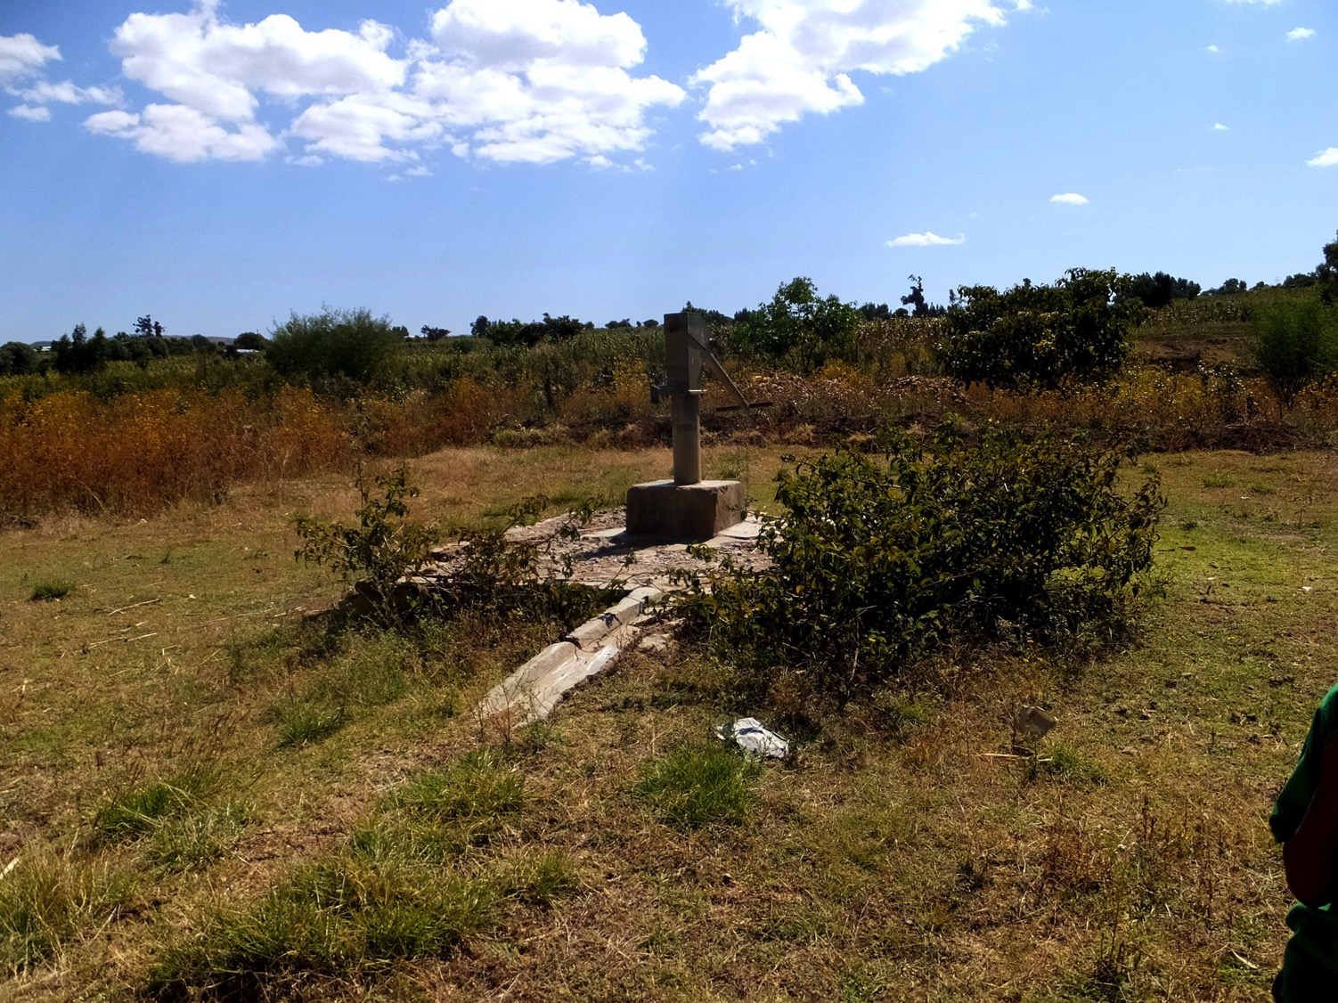
Well # 1 10 m, dry

Slide 35
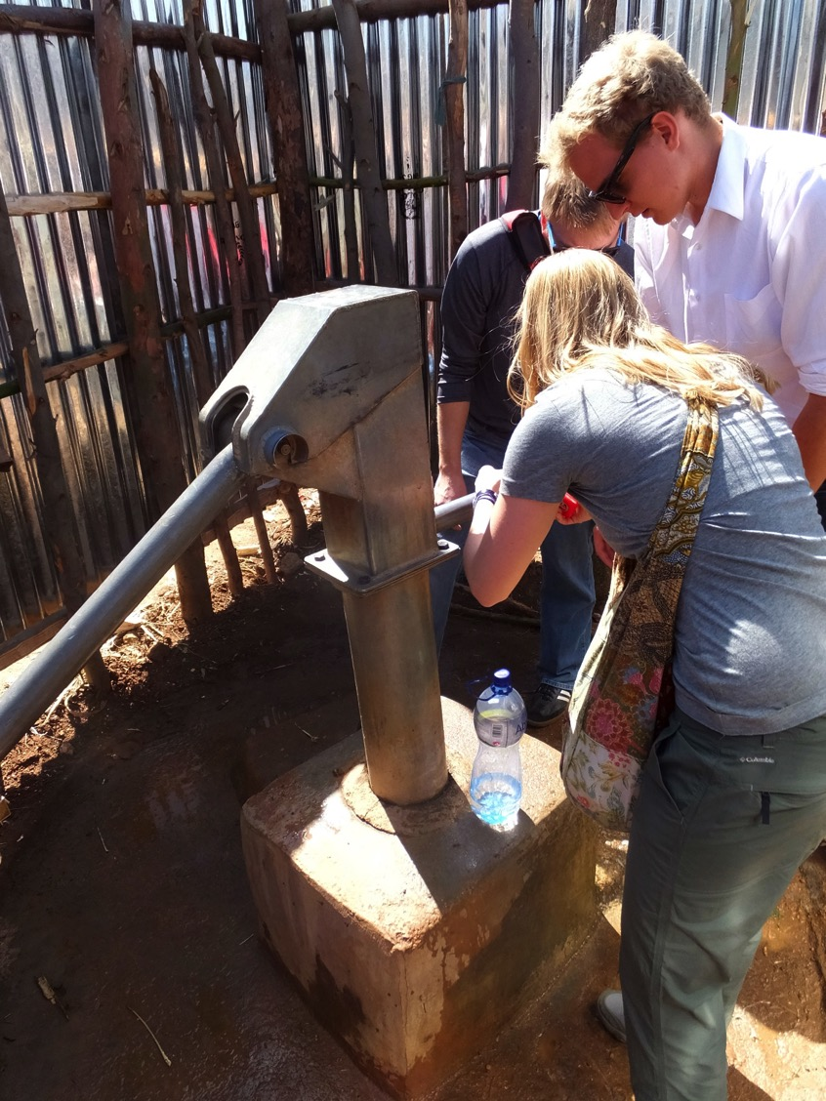
Well # 2
30 m, almost dry

Slide 36
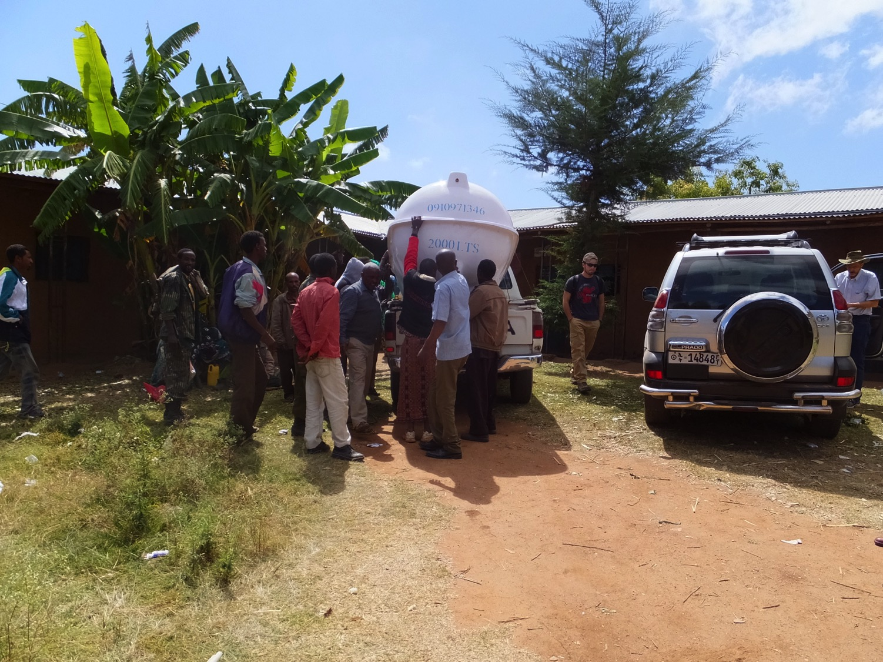

Slide 37
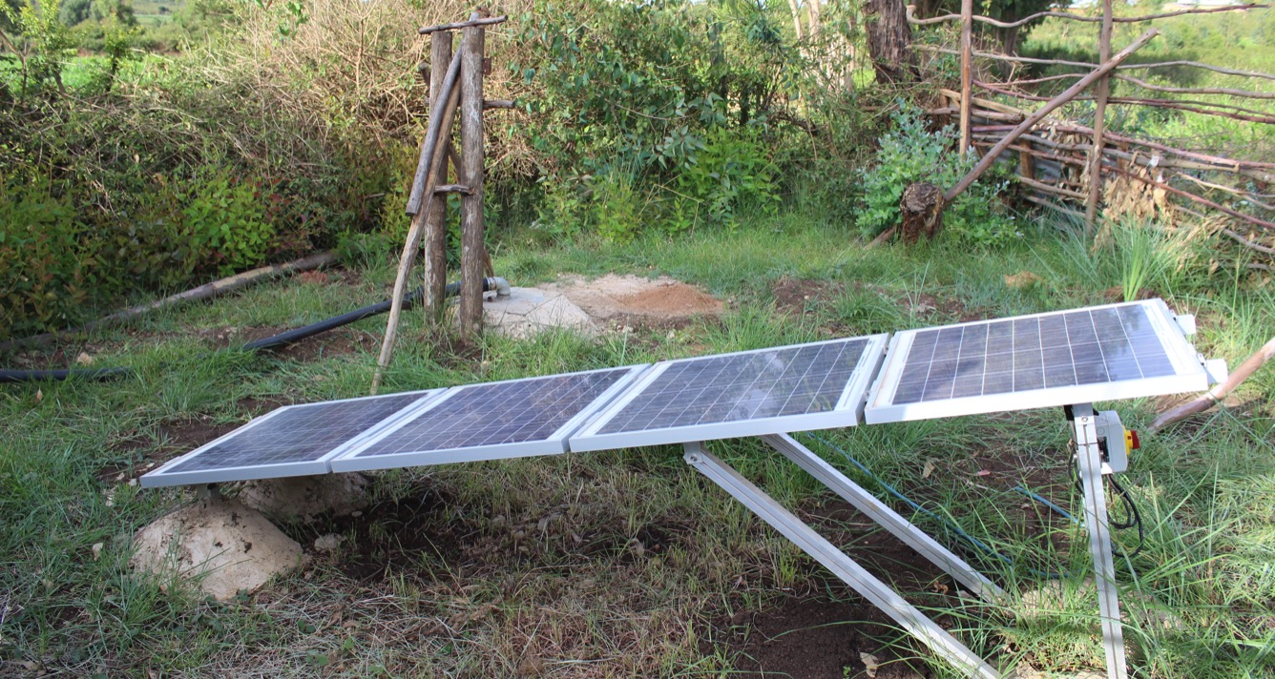

Slide 38
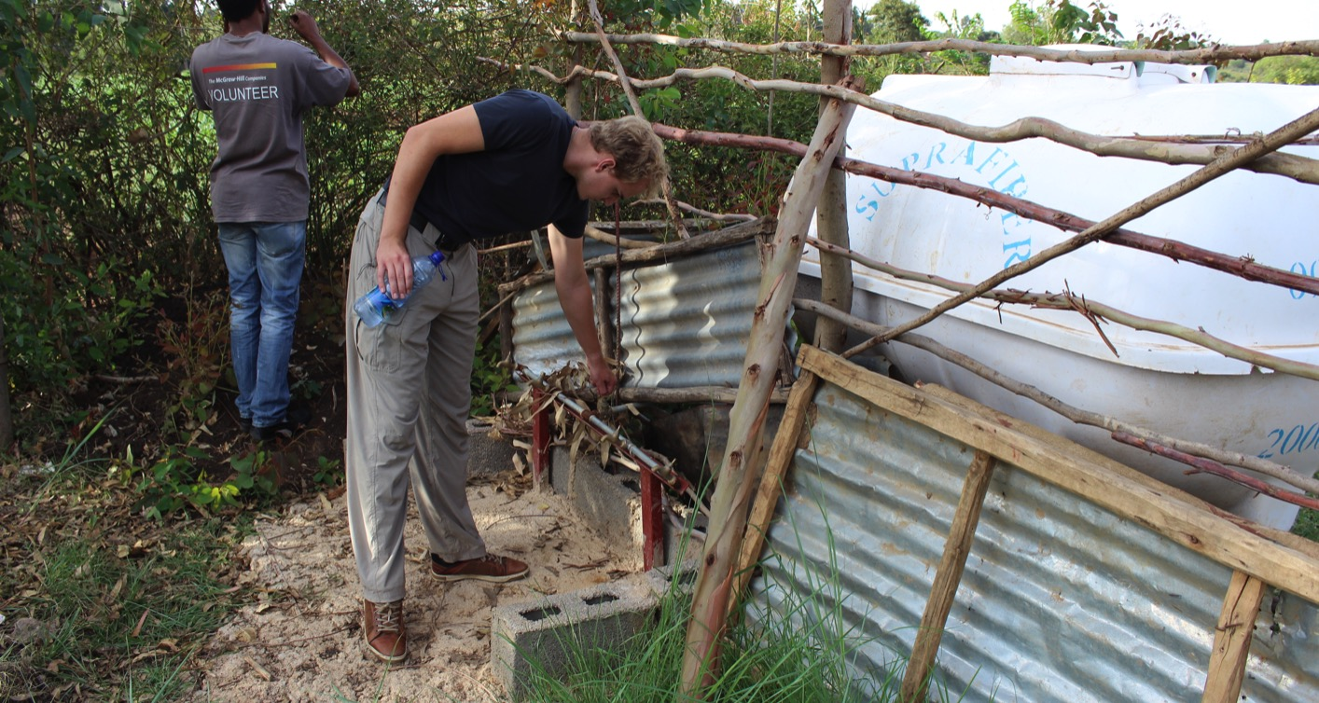

Slide 39
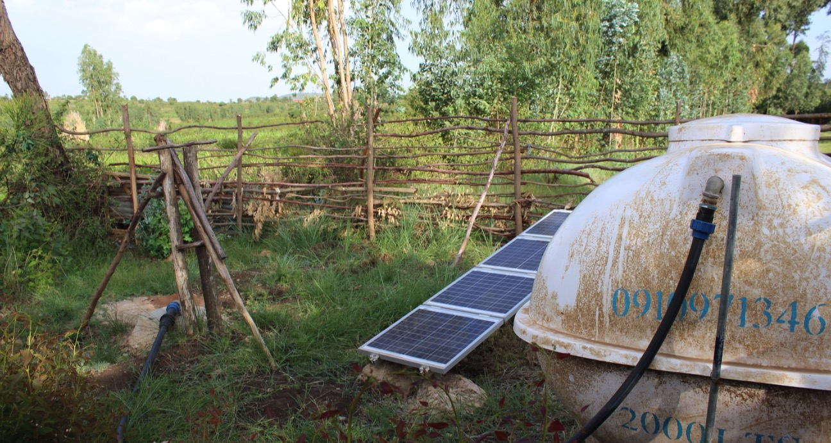

Slide 40
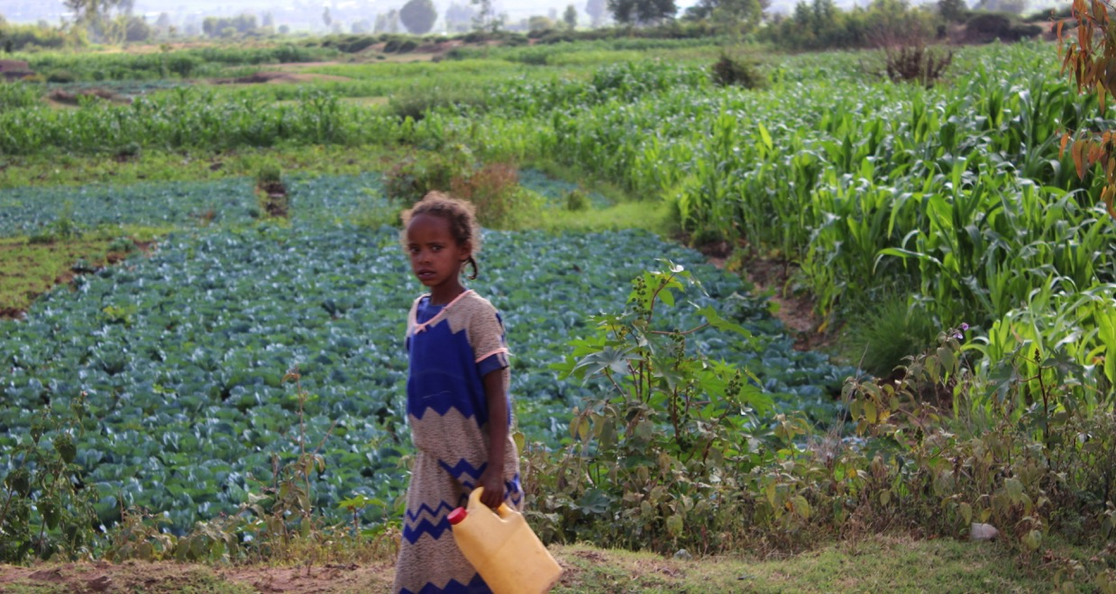

Slide 41
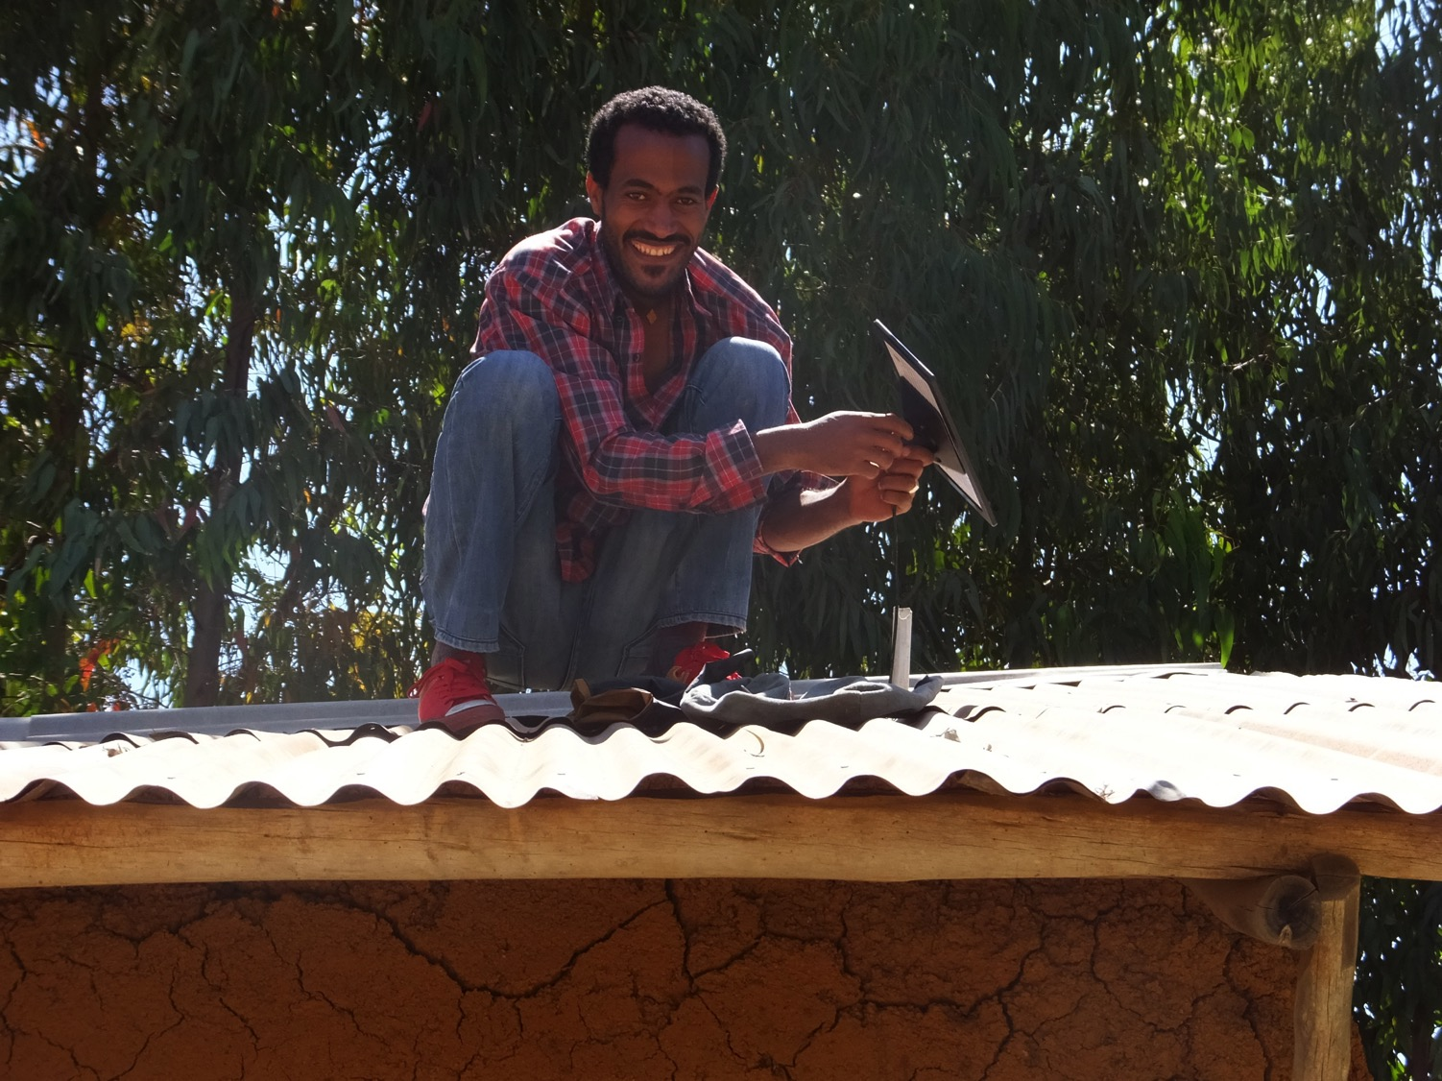

Slide 42
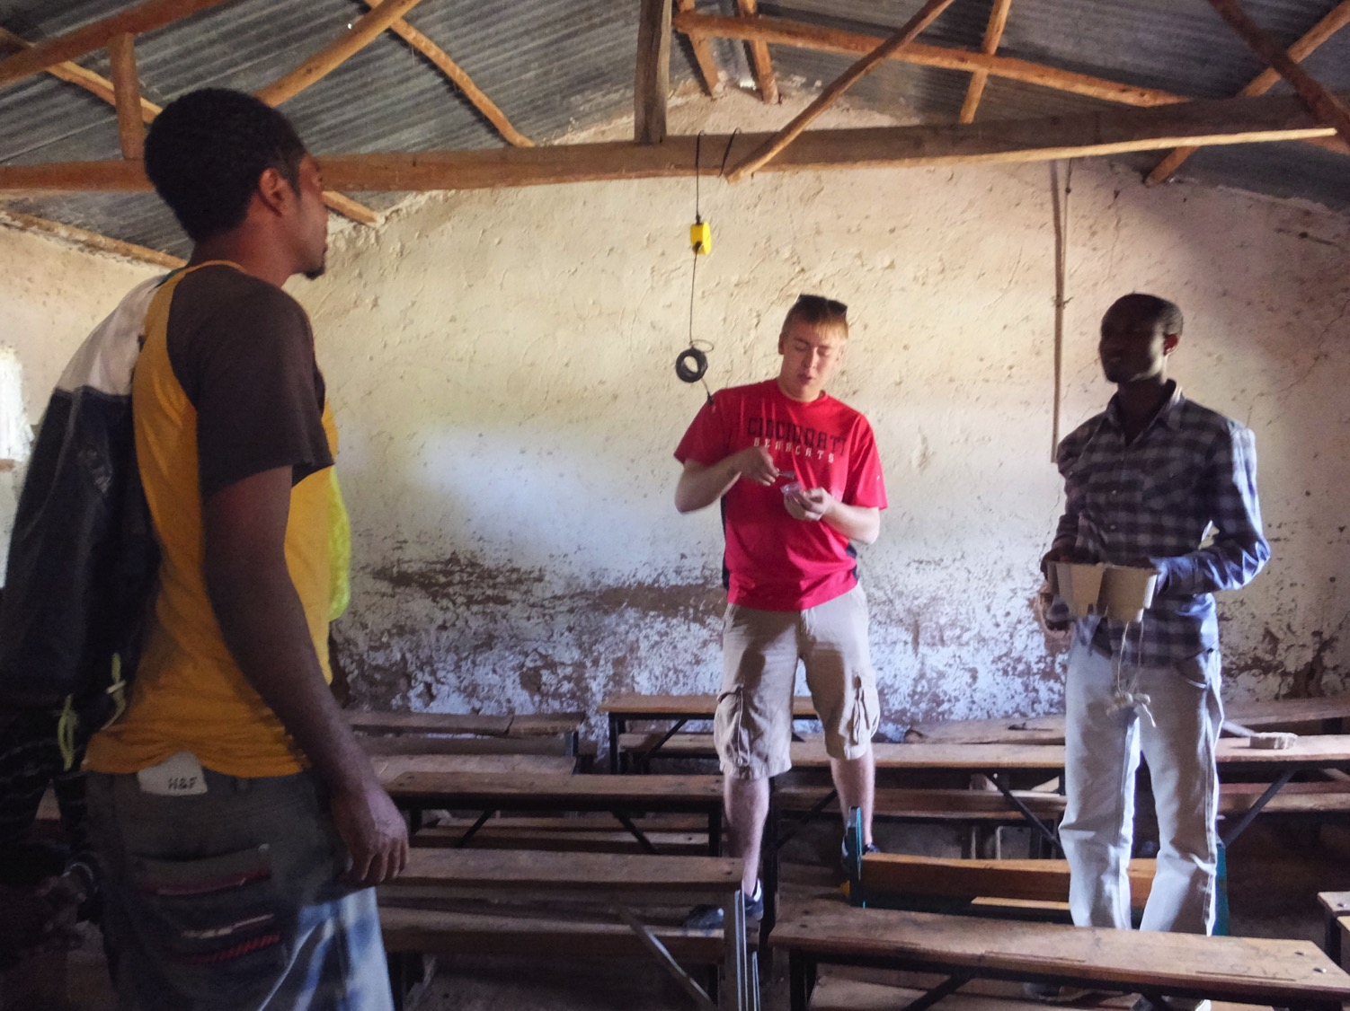

Slide 43
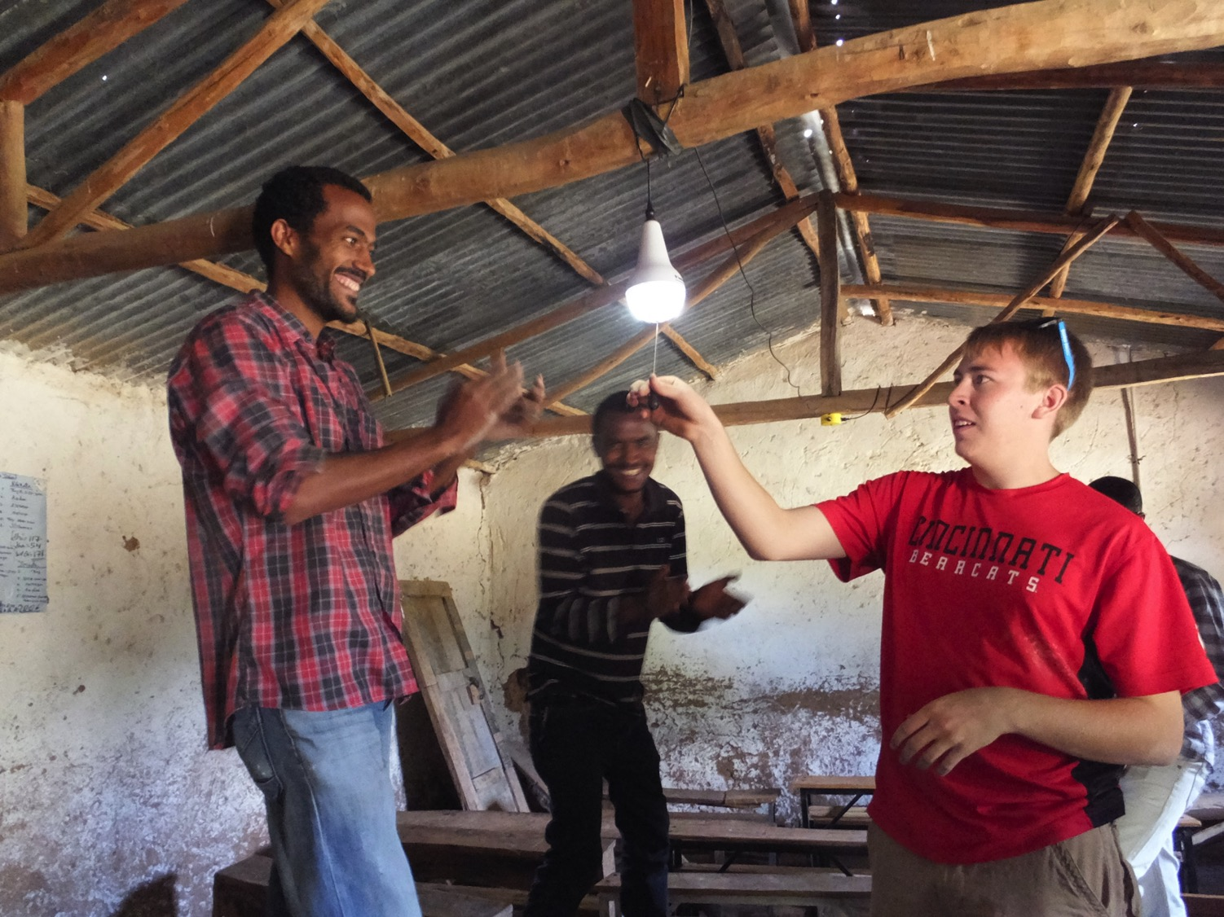

Slide 44
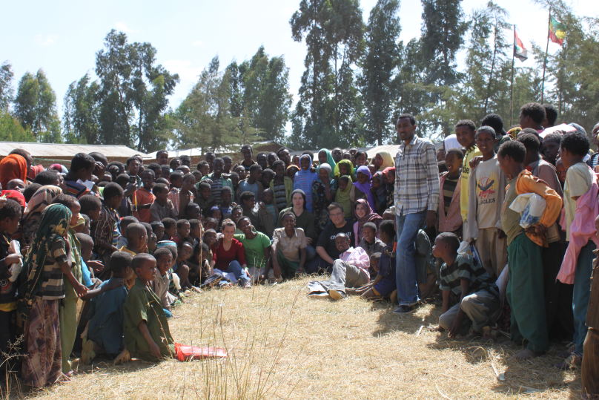

Slide 45
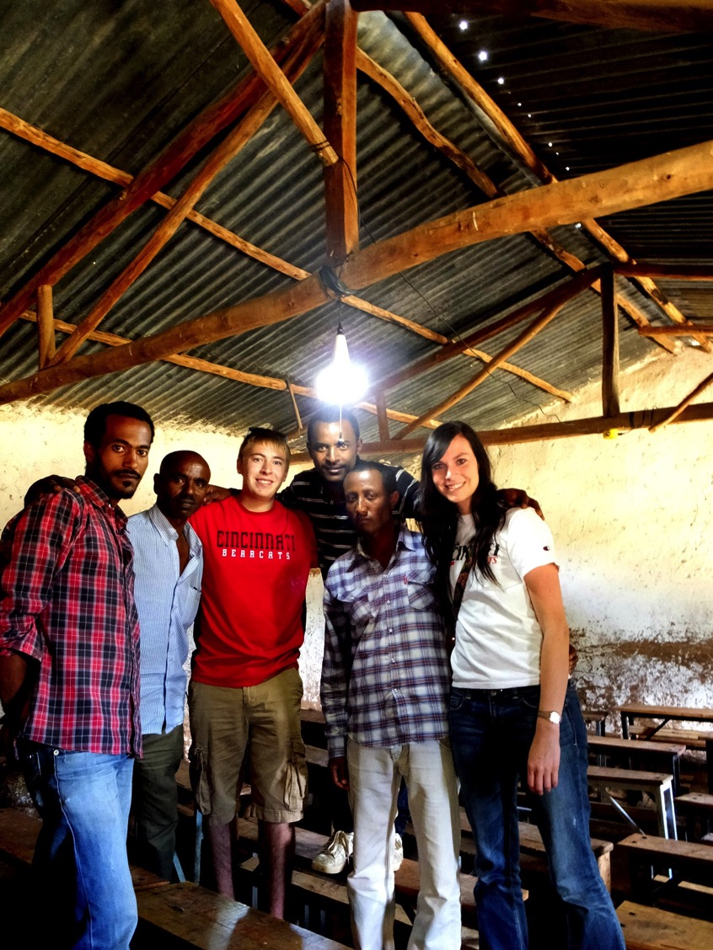

Slide 46
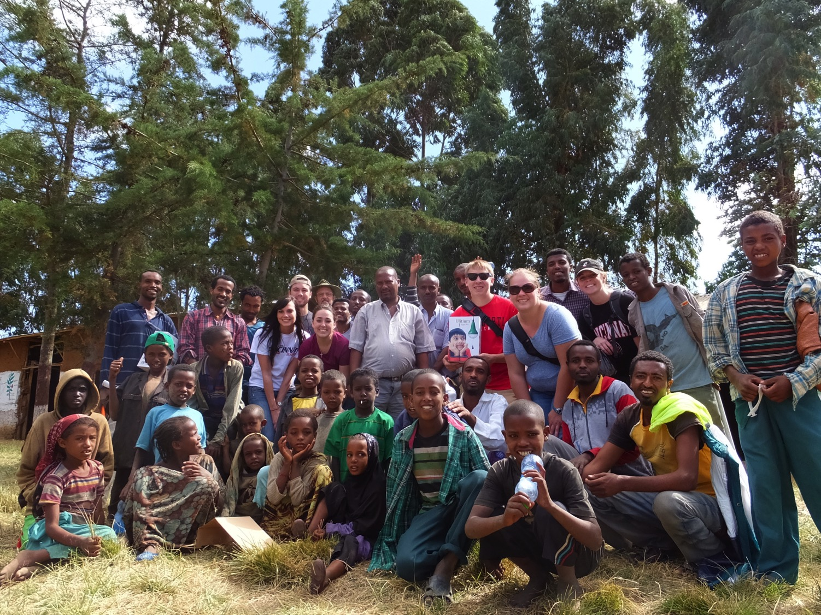

Slide 47
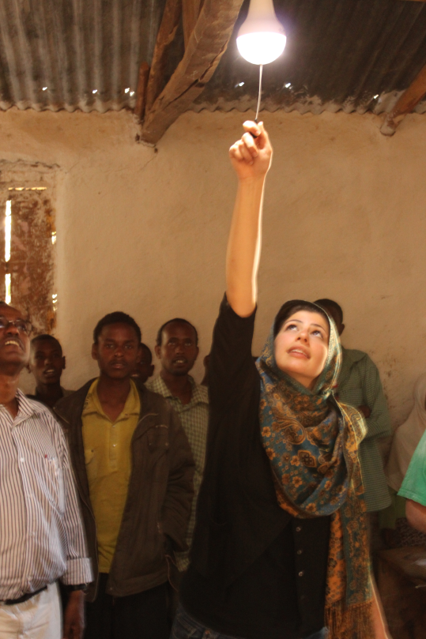

Slide 48
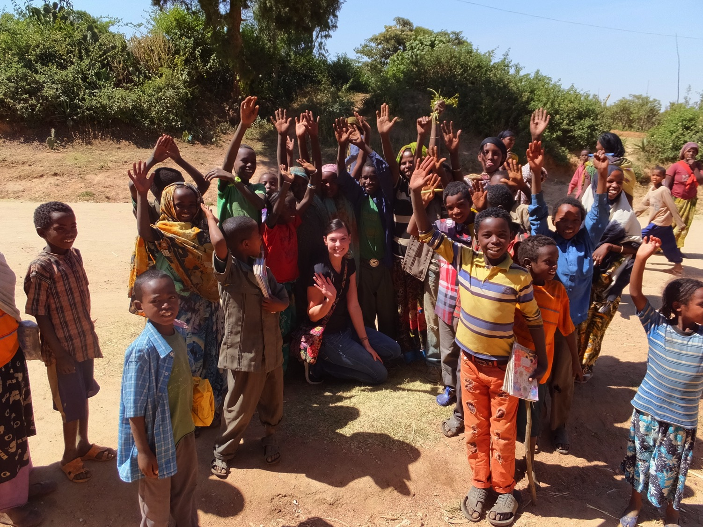

Slide 49
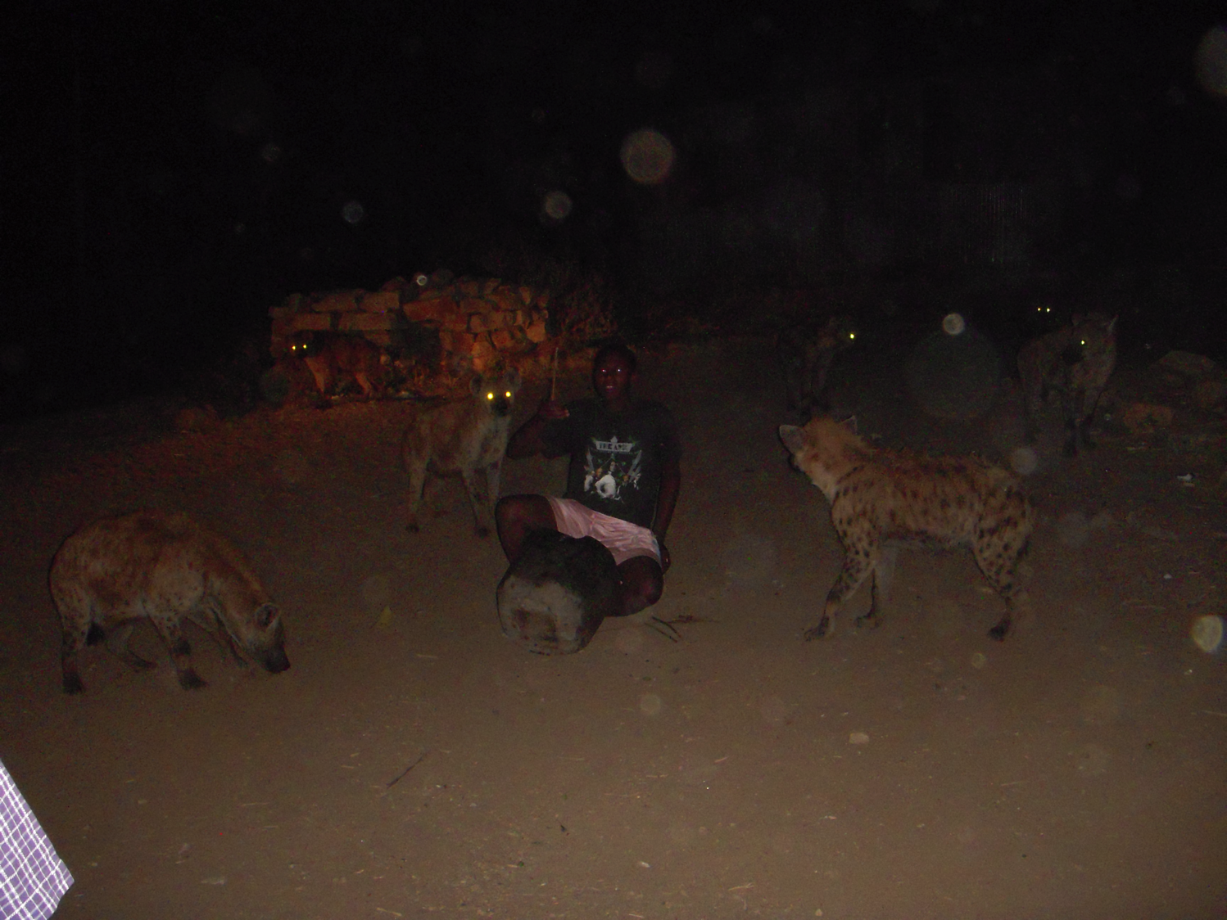

Slide 50
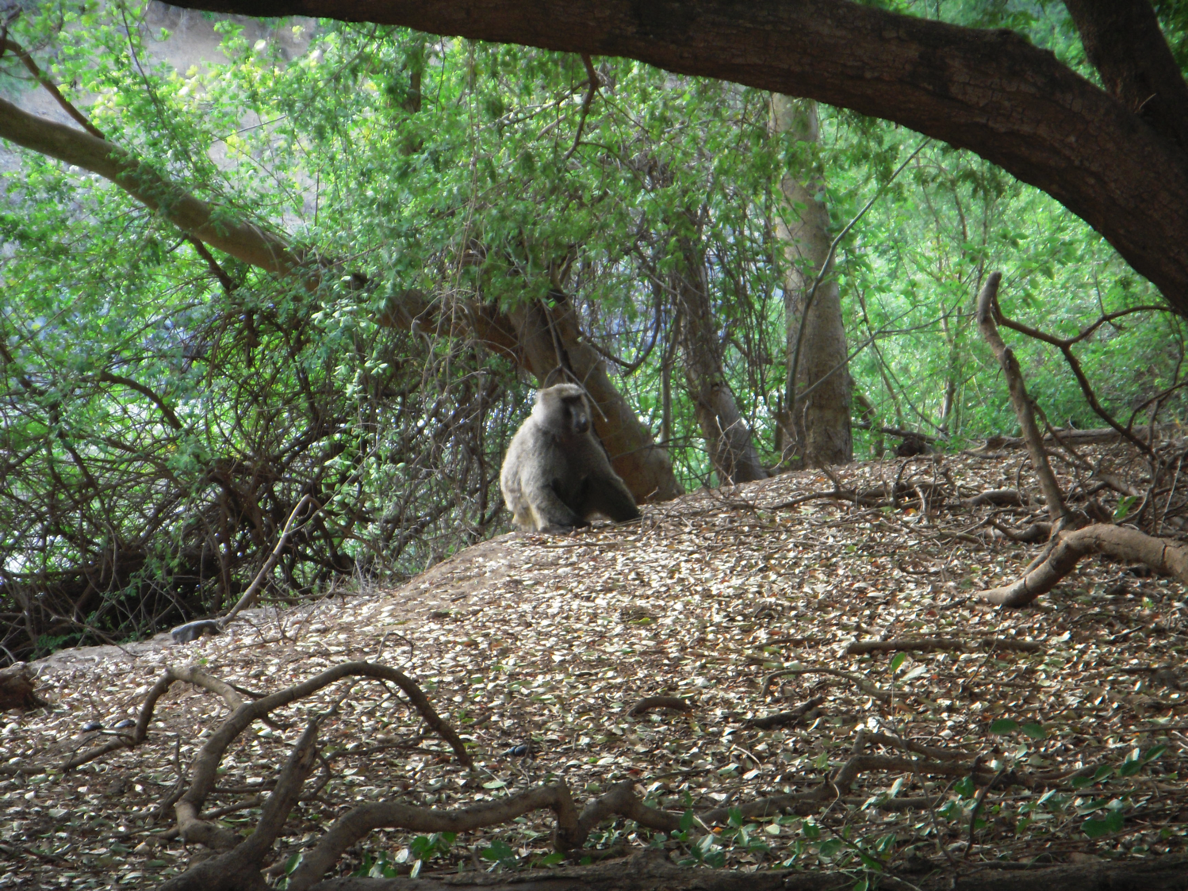

Slide 51


Slide 52
College Student Interaction and Community Outreach:
Outdoor lighting for safety improvement in a rural
Ethiopian village.
-Engineering, Architecture, Design, and Marketing undergraduate students from the University of Cincinnati (UC) will collaborate with their counterparts at Dire Dawa University (DDU) to assemble outdoor solar lighting from components as a learning experience for in country manufacture of solar lighting.
-The project will be conducted in December, during a visit by 14 UC students to Dire Dawa.
-A target village, in the Oromo Mountains, will be fitted with 35 outdoor lights that will improve safety and living standards in an area with no grid power
-Students will assess the impact and viability of a business model for the student designs.
-The interaction is expected to lead to long-term relationships between the US and Ethiopian students as well as between the two groups of students and the village.

Slide 53
College Student Interaction and Community Outreach:
Outdoor lighting for safety improvement in a rural
Ethiopian village.
-80 % of Marriages in the Oromia region of Ethiopia are by abduction.
-Partly this is an accepted cultural custom but partially it is against the girls will.
-Often abductions occur at night so improved lighting can help prevent unwanted abduction.

Slide 54

College Student Interaction and Community Outreach:
Outdoor lighting for safety improvement in a rural
Ethiopian village.

Slide 55

College Student Interaction and Community Outreach:
Outdoor lighting for safety improvement in a rural
Ethiopian village.

Slide 56

College Student Interaction and Community Outreach:
Outdoor lighting for safety improvement in a rural
Ethiopian village.

Slide 57

College Student Interaction and Community Outreach:
Outdoor lighting for safety improvement in a rural
Ethiopian village.

Slide 58

College Student Interaction and Community Outreach:
Outdoor lighting for safety improvement in a rural
Ethiopian village.

Slide 59


Slide 60

End

